Slide 1
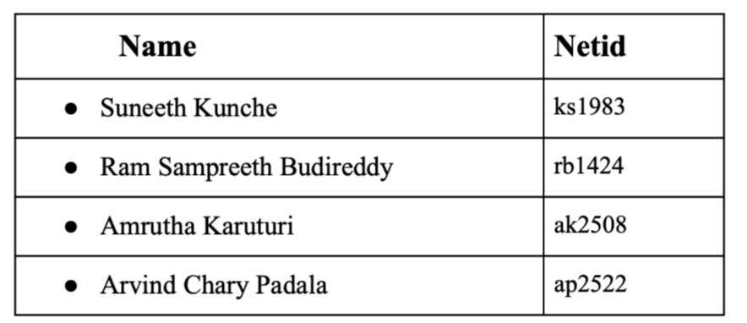
FIFA24 - Regression Analysis and Player Value Prediction

Slide 2
Objective
Predict soccer player values using regression models on the FIFA 24 Player Stats Dataset, providing insights into market valuation dynamics for strategic decision-making by soccer clubs.

Slide 3
Data Description
Player: The name of the football player.
Country: The nationality or home country of the player.
Height: The height of the player in centimeters.
Weight: The weight of the player in kilograms.
Age: The age of the player.
Club: The club to which the player is currently affiliated.
Ball Control: Player's skill in controlling the ball.
Dribbling: Player's dribbling ability.
Marking: Player's marking skill.
Slide Tackle: Player's ability to perform slide tackles.
Stand Tackle: Player's ability to perform standing tackles.
Aggression: Player's aggression level.
Reactions: Player's reaction time.
Attacking Position: Player's positioning for attacking plays.
Interceptions: Player's skill in intercepting passes.
Vision: Player's vision on the field.
Composure: Player's composure under pressure.
Crossing: Player's ability to deliver crosses.
Short Pass: Player's short passing accuracy.
Long Pass: Player's ability in long passing.
Acceleration: Player's acceleration on the field.
Stamina: Player's stamina level.
Strength: Player's physical strength.
Balance: Player's balance while playing.
Sprint Speed: Player's speed in sprints.
Agility: Player's agility in maneuvering.
Jumping: Player's jumping ability.
Heading: Player's heading skills.
Shot Power: Player's power in shooting.
Finishing: Player's finishing skills.
Long Shots: Player's ability to make long-range shots.
Curve: Player's ability to curve the ball.
Free Kick Accuracy: Player's accuracy in free-kick situations.
Penalties: Player's penalty-taking skills.
Volleys: Player's volleying skills.
Goalkeeper Positioning: Goalkeeper's positioning attribute (specific to goalkeepers).
Goalkeeper Diving: Goalkeeper's diving ability (specific to goalkeepers).
Goalkeeper Handling: Goalkeeper's ball-handling skill (specific to goalkeepers).
Goalkeeper Kicking: Goalkeeper's kicking ability (specific to goalkeepers).
Goalkeeper Reflexes: Goalkeeper's reflexes (specific to goalkeepers).
Value: The estimated value of the player

Slide 4
Agenda
Data Preprocessing
Visualization
Feature Engineering
Modelling
Hypothesis Testing
Model Improvements

Slide 5
Pre-processing
Data Cleaning
Null Value Treatment
Outlier Treatment

Slide 6
Preprocessing
Value column conversion: The Player value column in the data is in string format, so we removed the unnecessary characters and converted it into float. Further, we scaled the player value to millions to make visualizations simpler.
Null value treatment: More than 90% of the column has missing values, so we have decided to drop the particular column as replacing the missing values might result in reduced accuracy.
Outlier treatment: we defined a function, remove_outliers, which takes a DataFrame and a z-score threshold as parameters, the function identifies and removes outliers by filtering rows where the absolute z-scores in all columns exceed the specified threshold, mitigating the impact of extreme values on subsequent analyses.

Slide 7
Visualizations

Slide 8
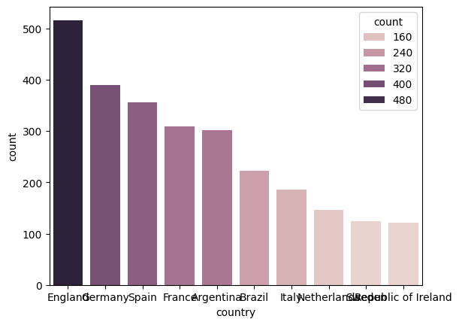
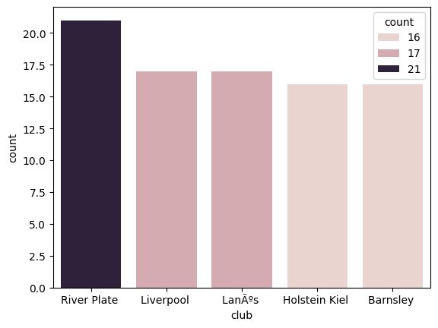
#Players per Country/Club
Top 10 Countries Based on No. of Players
Top 5 Clubs Based on No. of Players

Slide 9
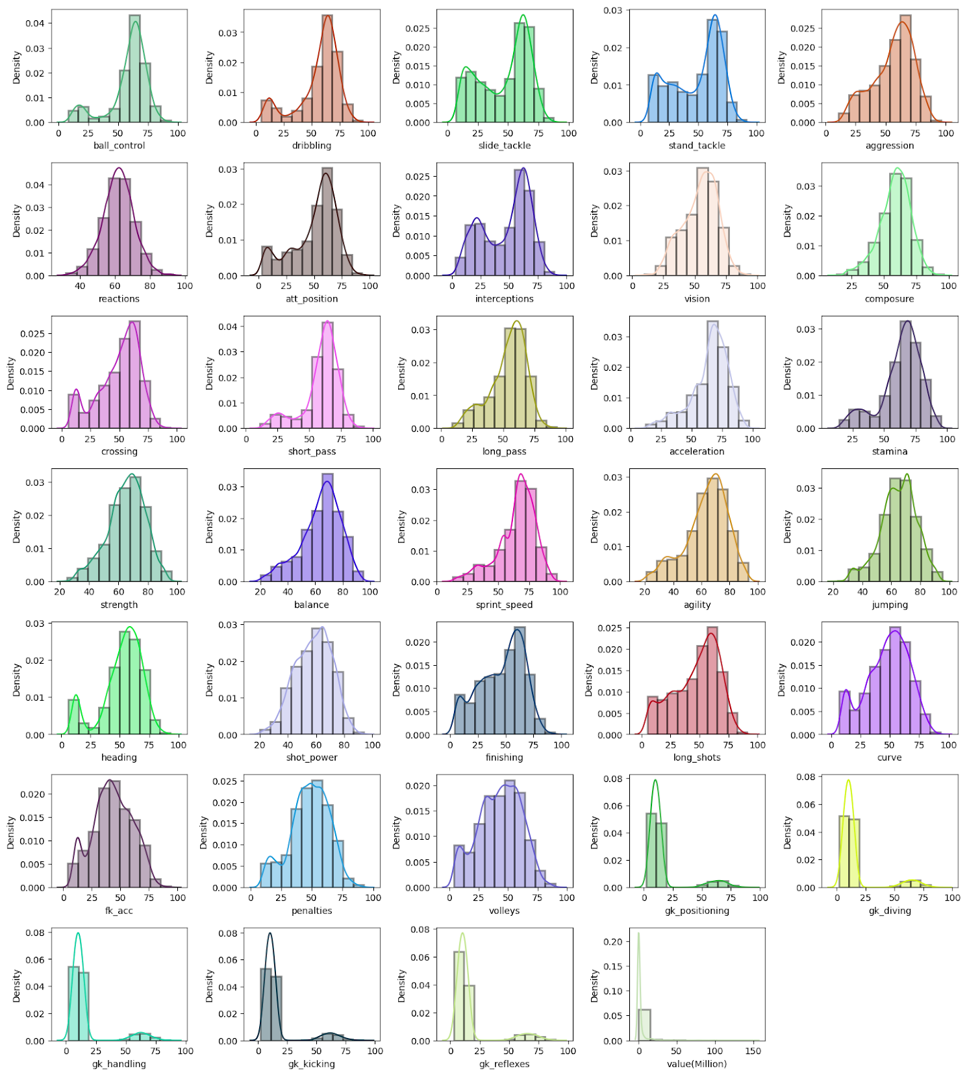
Numerical Features Distribution

Slide 10
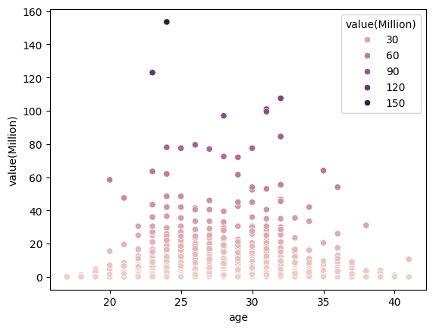
Player’s Age Vs Value

Slide 11
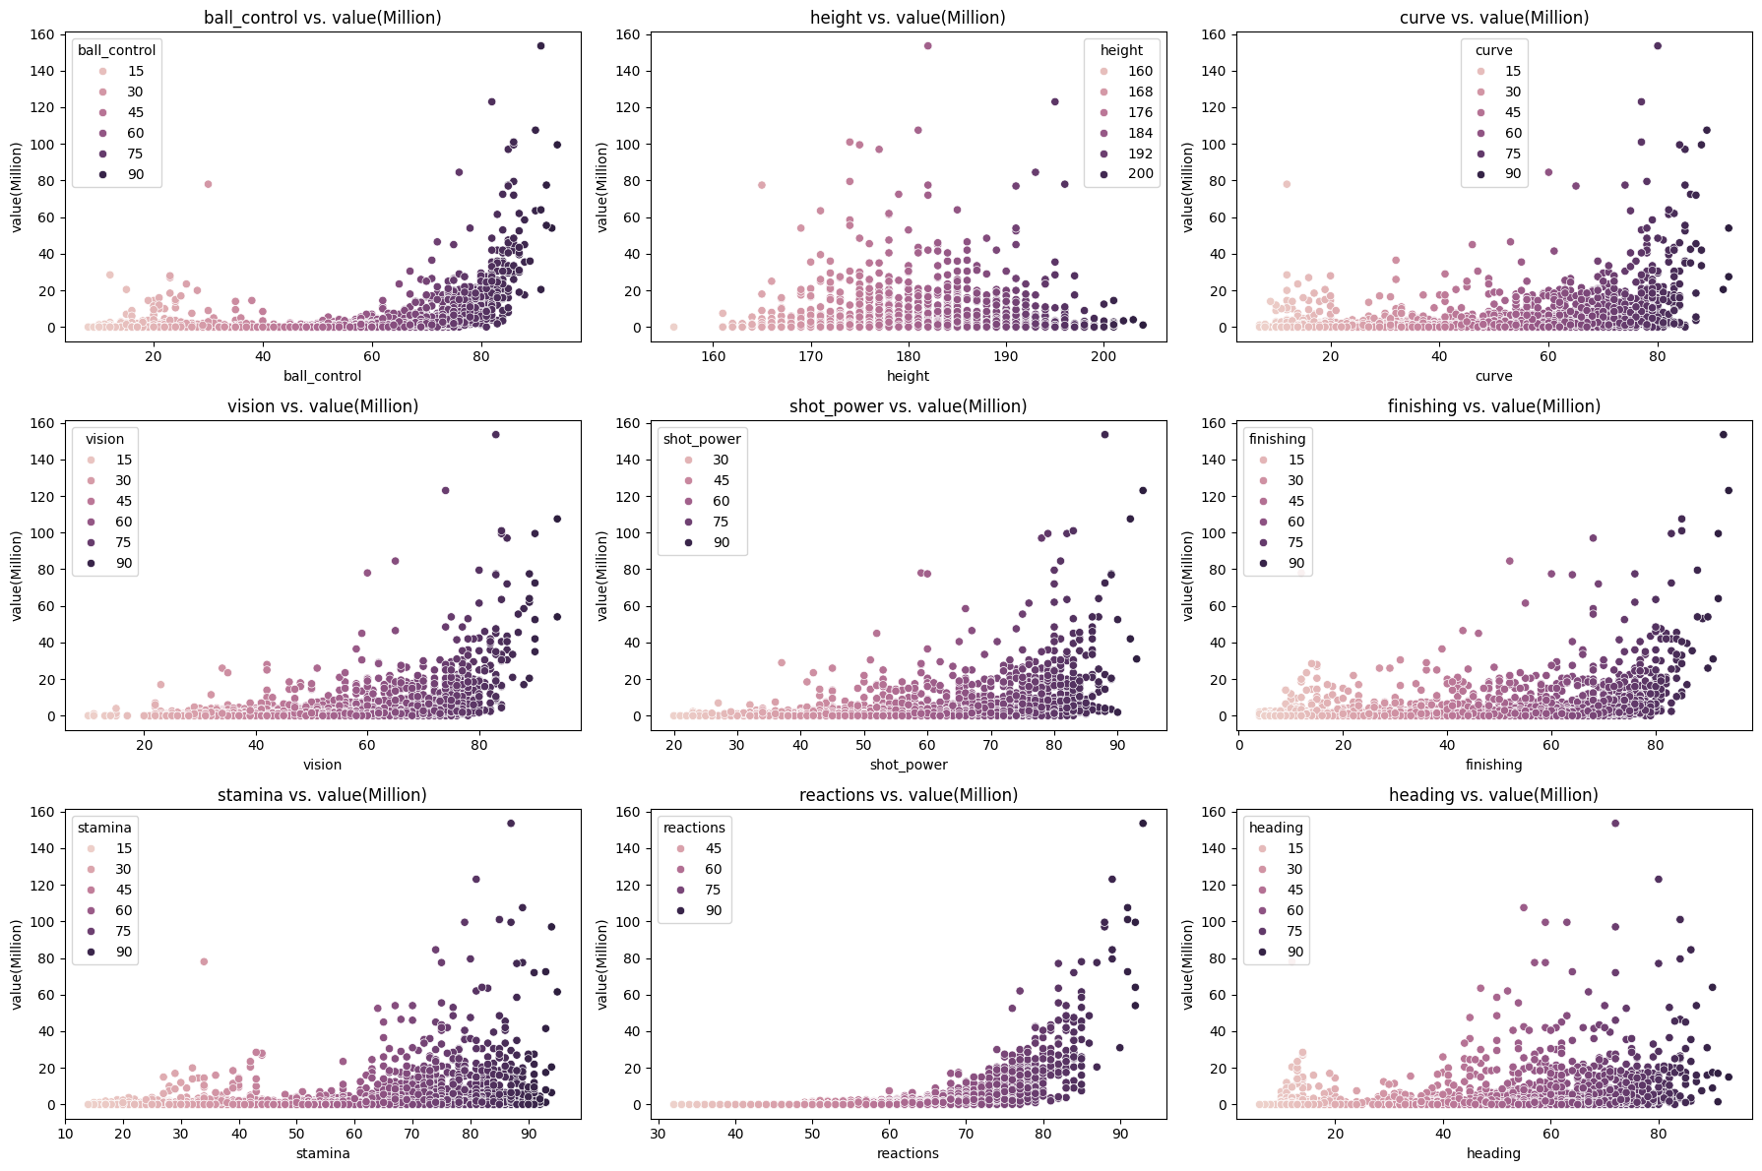
Scatterplots of some other features against Player Value

Slide 12
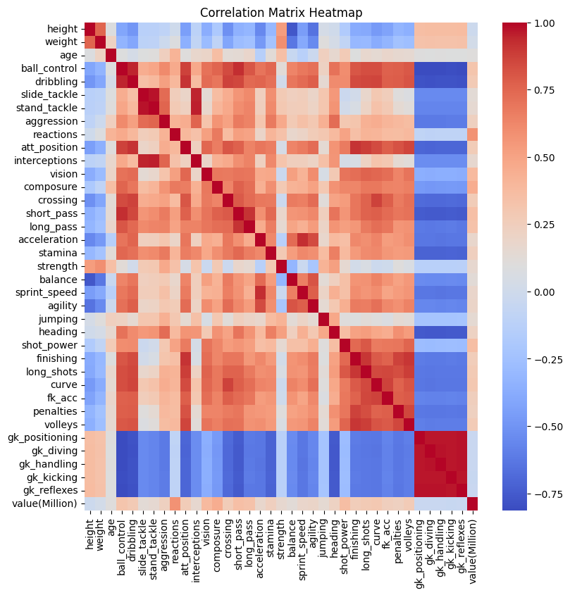
Correlation Heatmap

Slide 13
Feature Engineering
Feature Selection with Ridge Regularization
Feature Selection based on attribute Significance from Hypothesis Testing
Feature Reduction with PCA

Slide 14
Modelling

Slide 15
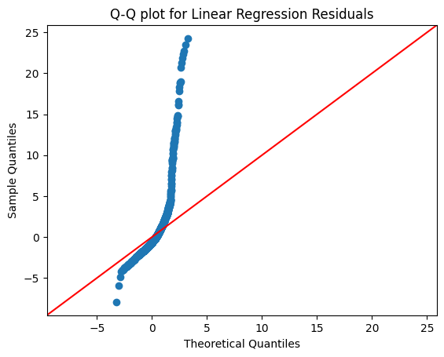
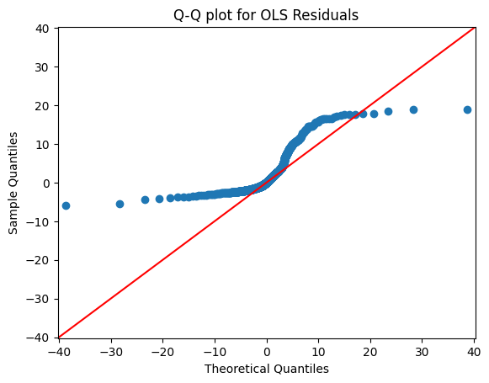
Modelling
Linear-Regression(scikit-learn)
RMSE | R^2
3.233079991126887 | 0.3896136375378023
Ordinary Least Squares Estimation
RMSE | R^2
3.222857346243236 | 0.489

Slide 16
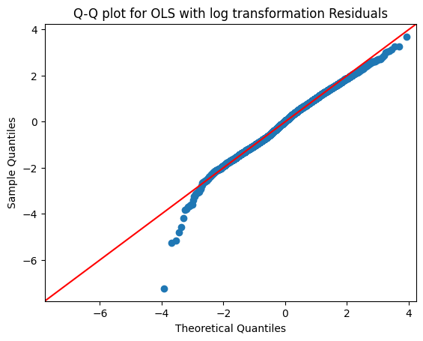
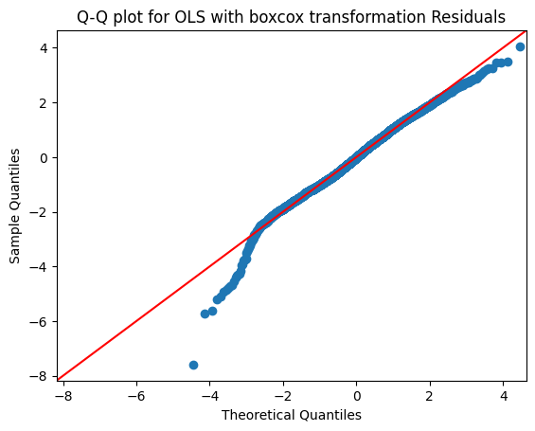
Modelling
OLS with log Transformation
RMSE | R^2
4.723467923706853 | 0.825
OLS with box-cox Transformation
RMSE | R^2
5.0443790758369955 | 0.839

Slide 17

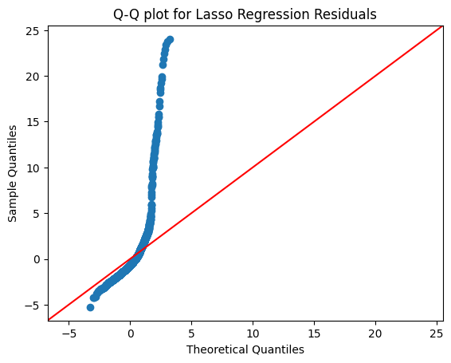
Modelling
Ridge Regression
RMSE | R^2
3.2049928647223513 | 0.4001729372757731
Lasso Regression
RMSE | R^2
3.2830299287585074 | 0.3706074384439773

Slide 18
Hypothesis Testing

Slide 19
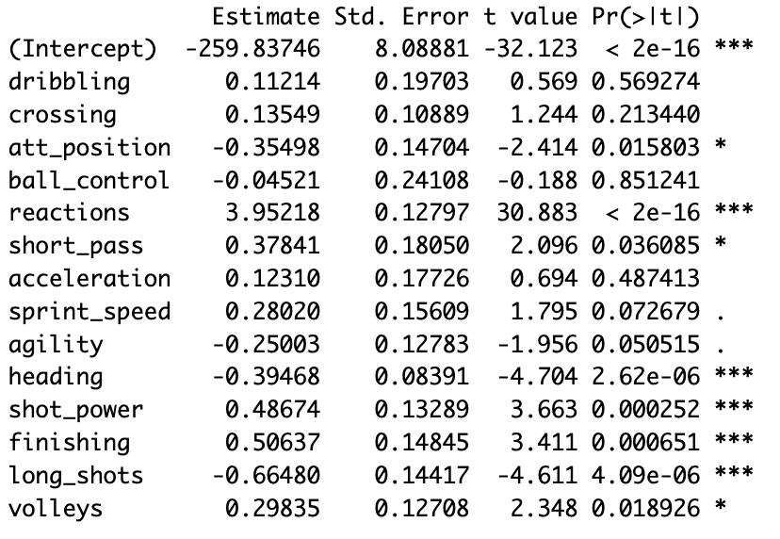
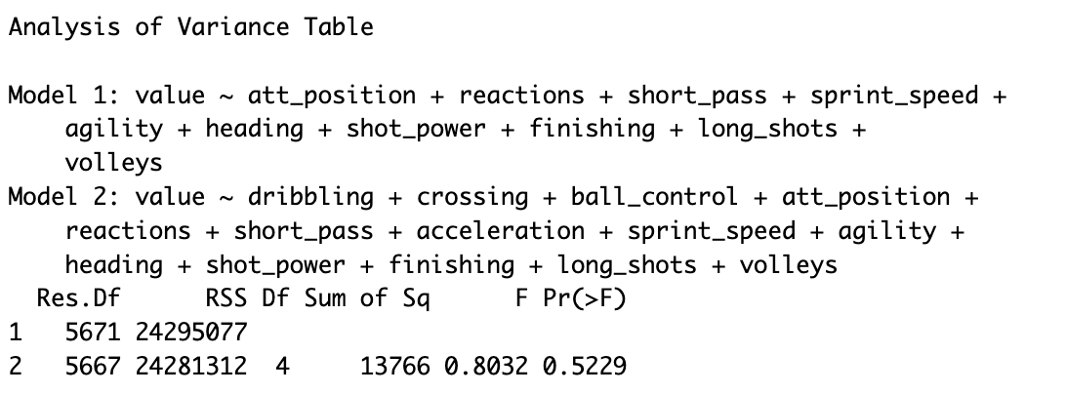
Model with the possible features of the striker:
Model: value ~ dribbling + crossing + att_position + reactions + short_pass + acceleration + sprint_speed + agility + heading + shot_power + finishing + long_shots + volleys
H0: 𝛽dribbling=𝛽crossing=𝛽ball_control=𝛽acceleration= 0 Vs
H1: At Least one of 𝛽dribbling, 𝛽crossing, 𝛽ball_control, 𝛽acceleration ≠ 0
p-value is large => H0(restricted model) not rejected => dribbling, crossing, ball_control, acceleration do not have significant effect on the value

Slide 20
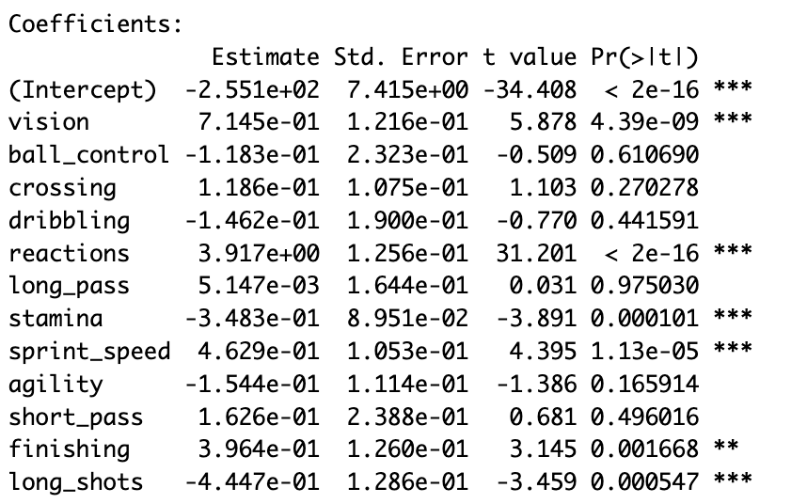
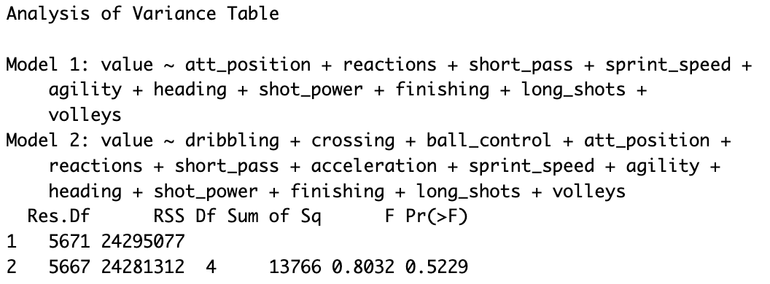
2) Model with the possible features of the midfielder:
Model : value ~ vision + ball_control + crossing + dribbling + reactions + long_pass + stamina + sprint_speed + agility + short_pass + finishing + long_shots
H0:𝛽dribbling=𝛽crossing=𝛽ball_control=𝛽long_pass=𝛽agility=𝛽short_pass= 0 Vs
H1: Atleast one of 𝛽dribbling, 𝛽crossing, 𝛽ball_control, 𝛽long_pass, 𝛽short_pass, 𝛽agility ≠ 0
p-value is large => H0(restricted model) not rejected => dribbling, crossing, ball_control, long_pass,short_pass, agility do not have significant effect on the value.

Slide 21
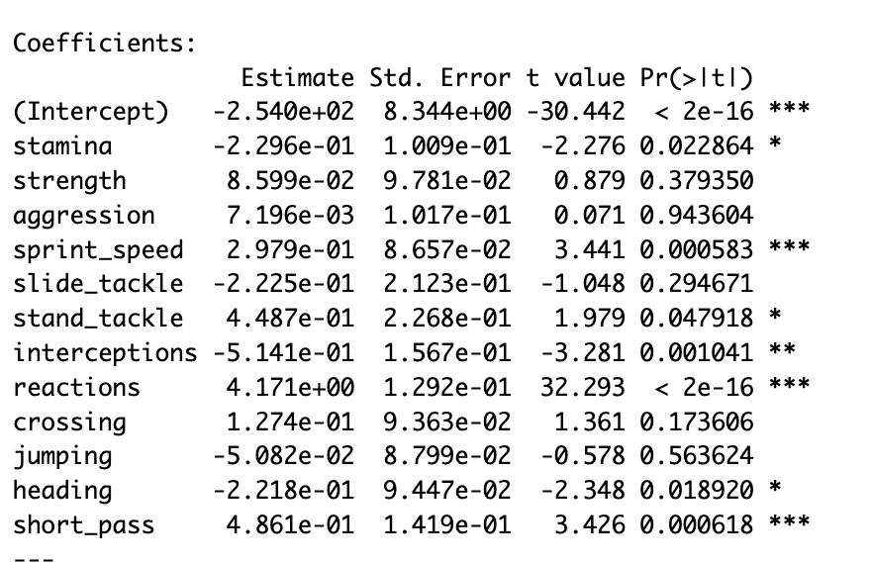
3) Model with the possible features of the defender:
Model: value~stamina + strength + aggression + sprint_speed + slide_tackle + stand_tackle + interceptions + reactions + crossing + sprint_speed + jumping + heading + short_pass
H0:𝛽strength=𝛽aggression=𝛽slide_tackle=𝛽crossing=𝛽jumping= 0 Vs
H1: At Least one of 𝛽strength, 𝛽aggression, 𝛽slide_tackle, 𝛽crossing, 𝛽jumping ≠ 0
p-values is large => H0(restricted model) not rejected =>strength, aggression, slide_tackle, crossing, jumping do not significantly affect the value.

Slide 22
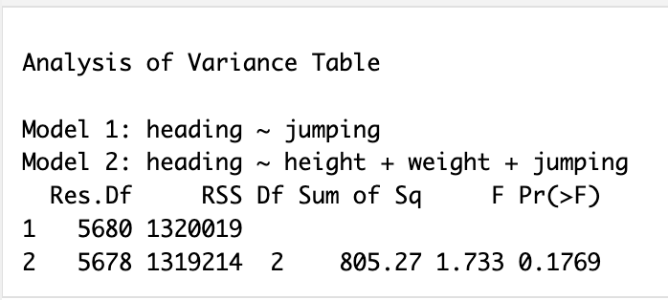
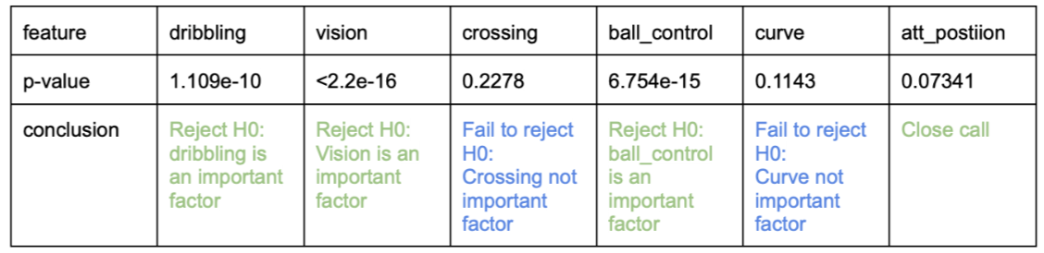
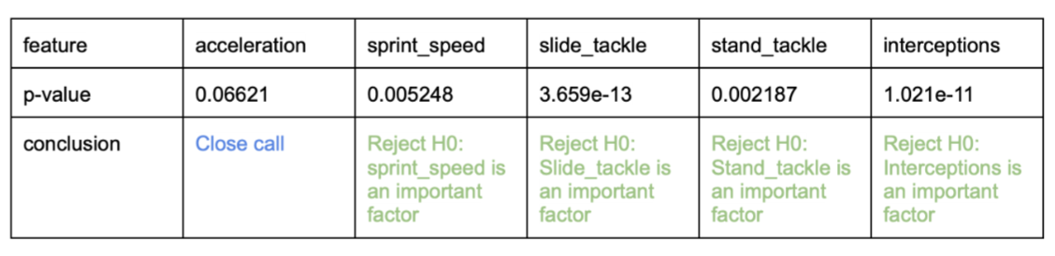
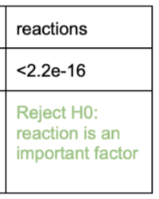
4)Model: heading ~height + weight + jumping
H0:𝛽height=𝛽weight= 0 Vs H1: At Least one of 𝛽height, 𝛽weight ≠ 0
p-value is large => H0(restricted model) not rejected =>height and weight do not have significant effect on heading.

Slide 23
Model Improvements

Slide 24
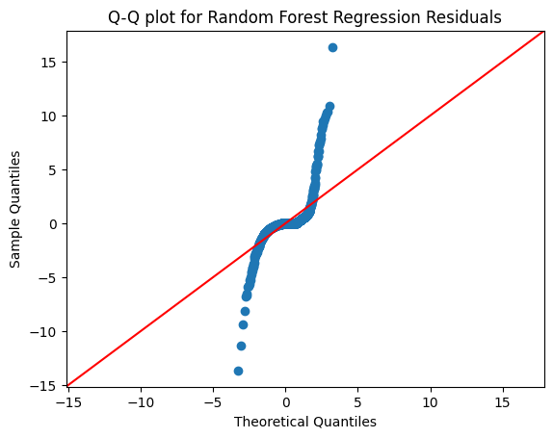
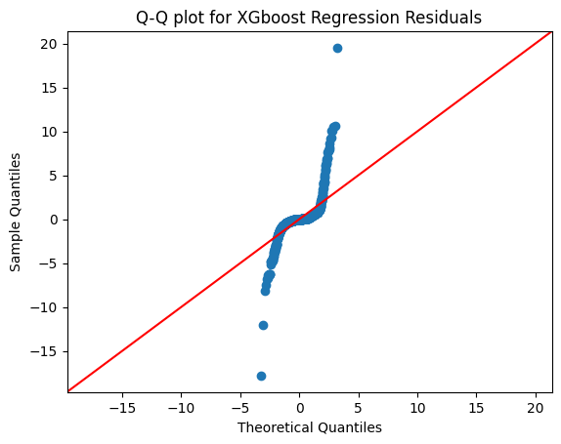
Random Forest Regressor
RMSE | R^2
1.5152210320565866 | 0.865932379285945
XGboost Regressor
RMSE | R^2
1.5255279598790699 | 0.8641022501782685

Slide 25
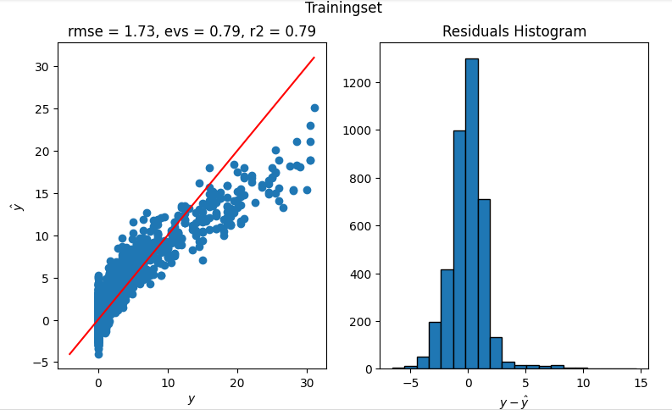
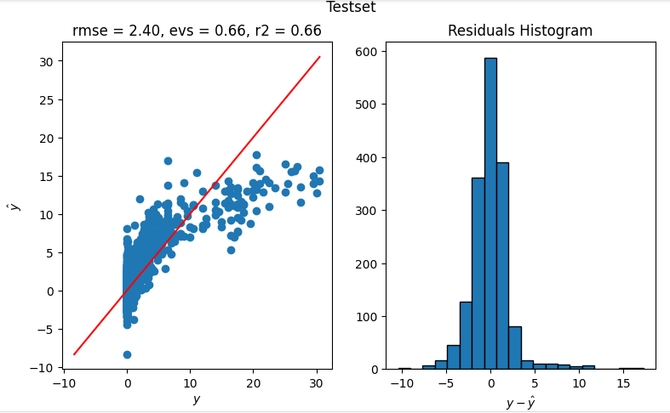
Ridge Regularisation with Pipeline Model

Slide 26
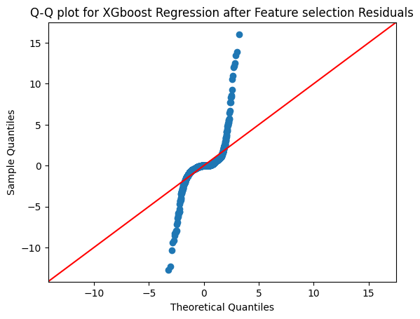
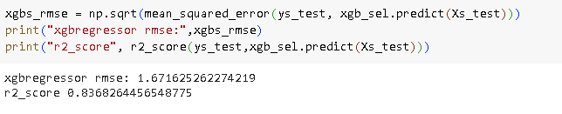
XGBoost After Feature Selection

Slide 27
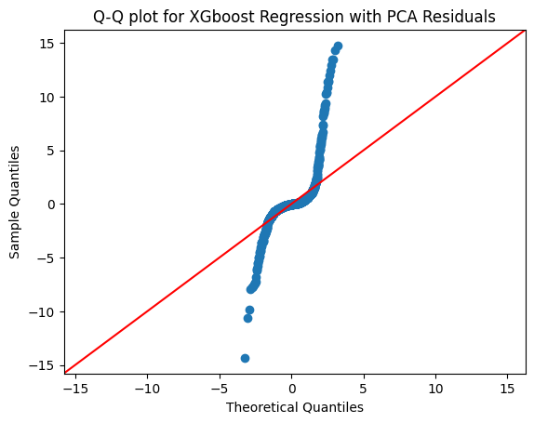
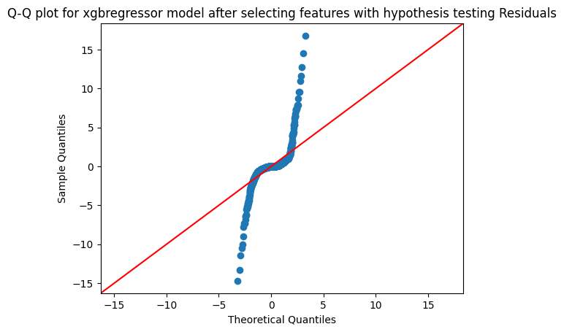
XGBoost with PCA
RMSE | R^2
1.8776395523021796 | 0.7941284319905643
XGBoost with Feature Selection based on Hypothesis Testing
RMSE | R^2
1.634440755713893 | 0.8440051400707622

Slide 28
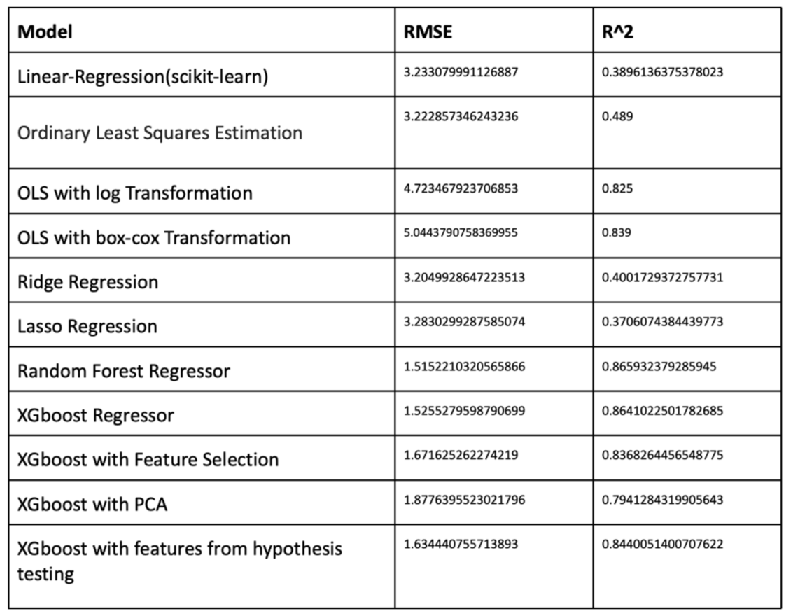
Conclusion
Feature selection techniques, especially with XGBoost and hypothesis testing, proved effective in maintaining accuracy while improving interpretability.
In conclusion, Random Forest and XGBoost Regressors are robust choices that outperform traditional linear methods. Careful consideration of feature selection techniques is crucial, balancing simplicity and explanatory power.

